Slide 1
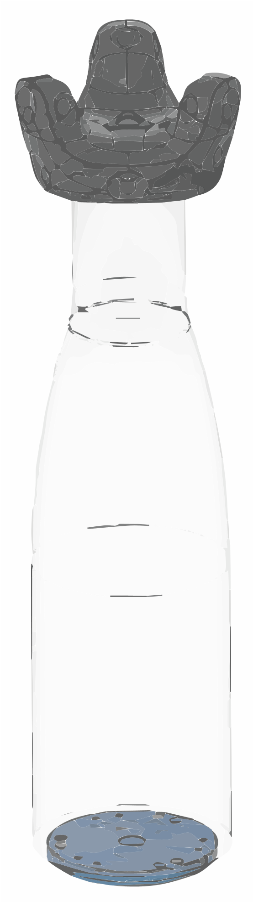
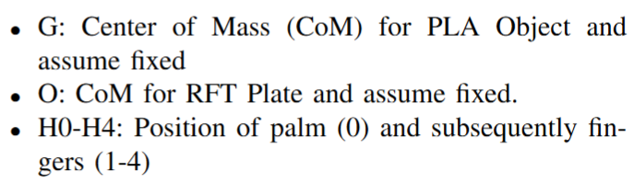
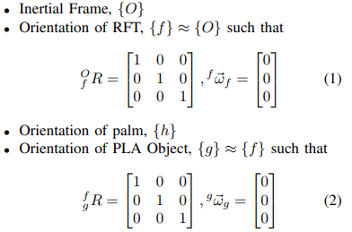
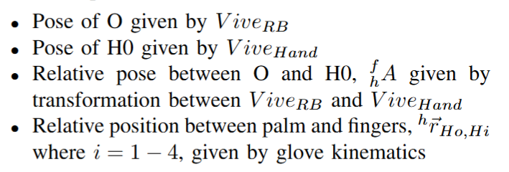
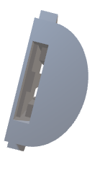
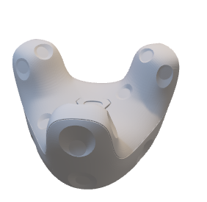
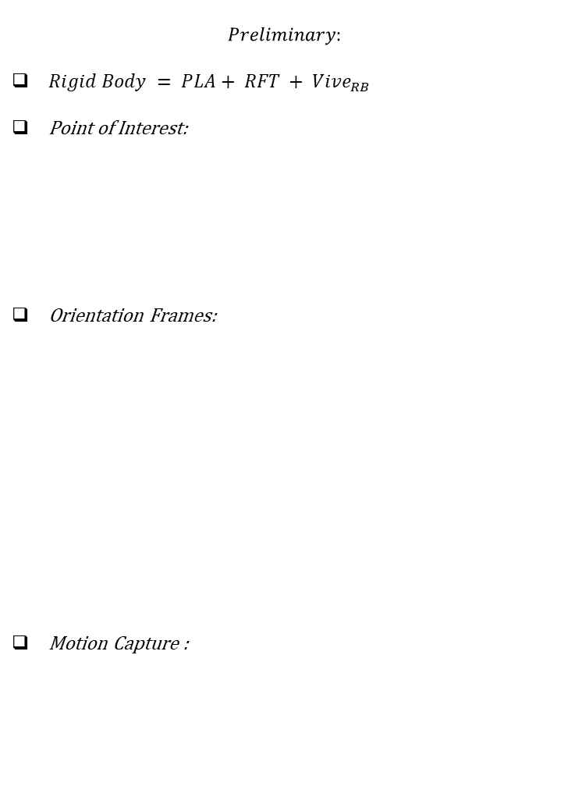
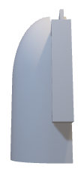
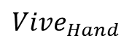

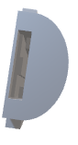
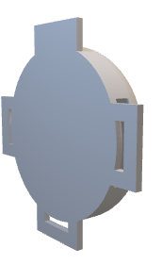
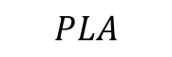
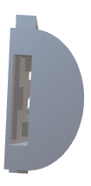
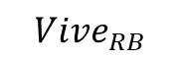
Study 1: Interaction Force and Torque on Static Rigid Body
$$Preliminary:$$
$Rigid Body = PLA+ RFT + Vive_{RB}$
Point of Interest:
Orientation Frames:
Motion Capture :
$$Vive_{RB}$$
$$PLA$$
H2
H1
G
{g}
H3
$$Vive_{Hand}$$
{h}
H0
Z
H4
Point
{frame}
X
{O,f}
O
Y
$$RFT$$
Notes:
Include FBD, standardize the notations, for the static rigid body, start overleaf project to write the maths properly

Slide 2
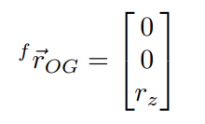
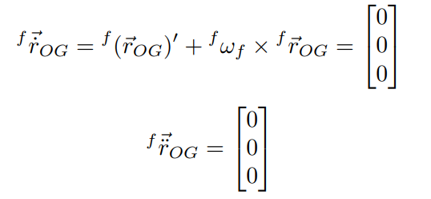
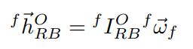
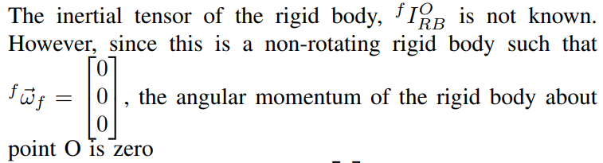
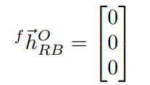
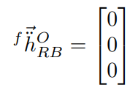


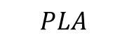
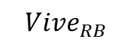
Kinematics
Linear
$$Vive_{RB}$$
$$PLA$$
H2
H1
Angular
G
{g}
H3
$$Vive_{Hand}$$
{h}
H0
Z
H4
Point
{frame}
X
{O,f}
O
Y
$$RFT$$
Notes:
Include FBD, standardize the notations, for the static rigid body, start overleaf project to write the maths properly

Slide 3
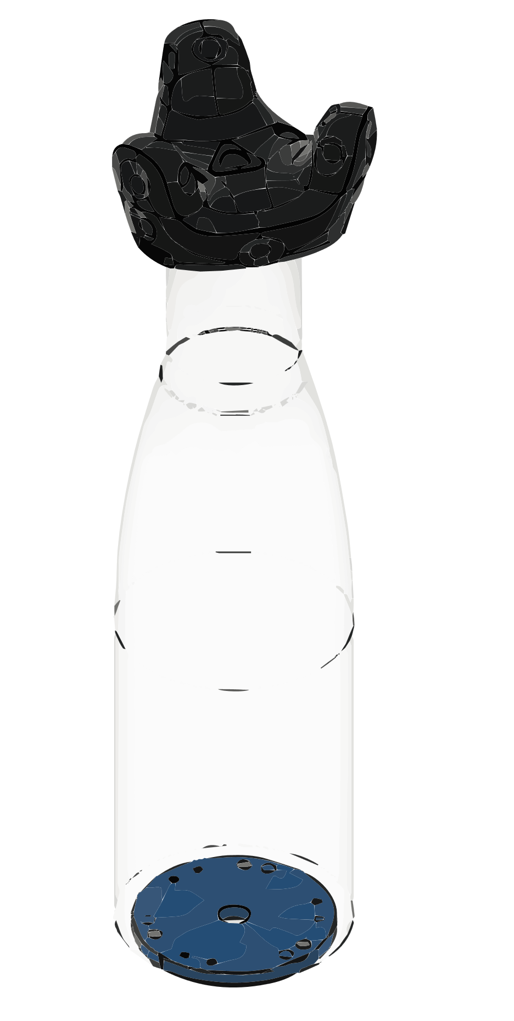


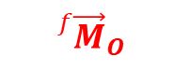





Dynamics (Free Body Diagram)
$${}_{}^{h}{{\vec{F}}_{2}}$$
H2
$${}_{}^{h}{{\vec{F}}_{1}}$$
H1
$${}_{}^{h}{{\vec{F}}_{3}}$$
{h}
H3
{g}
H0
$${}_{}^{h}{{\vec{F}}_{0}}$$
G
$${}_{}^{h}{{\vec{F}}_{4}}$$
$${}_{}^{f}{{\vec{F}}_{G}}$$
H4
Actuation Wrenches
Constraint Wrenches
Gravitational Wrenches
{f}
O
$${}_{}^{f}{{\vec{F}}_{O}}$$
$${}_{}^{f}{{\vec{M}}_{O}}$$
Notes:
Include FBD, standardize the notations, for the static rigid body, start overleaf project to write the maths properly

Slide 4
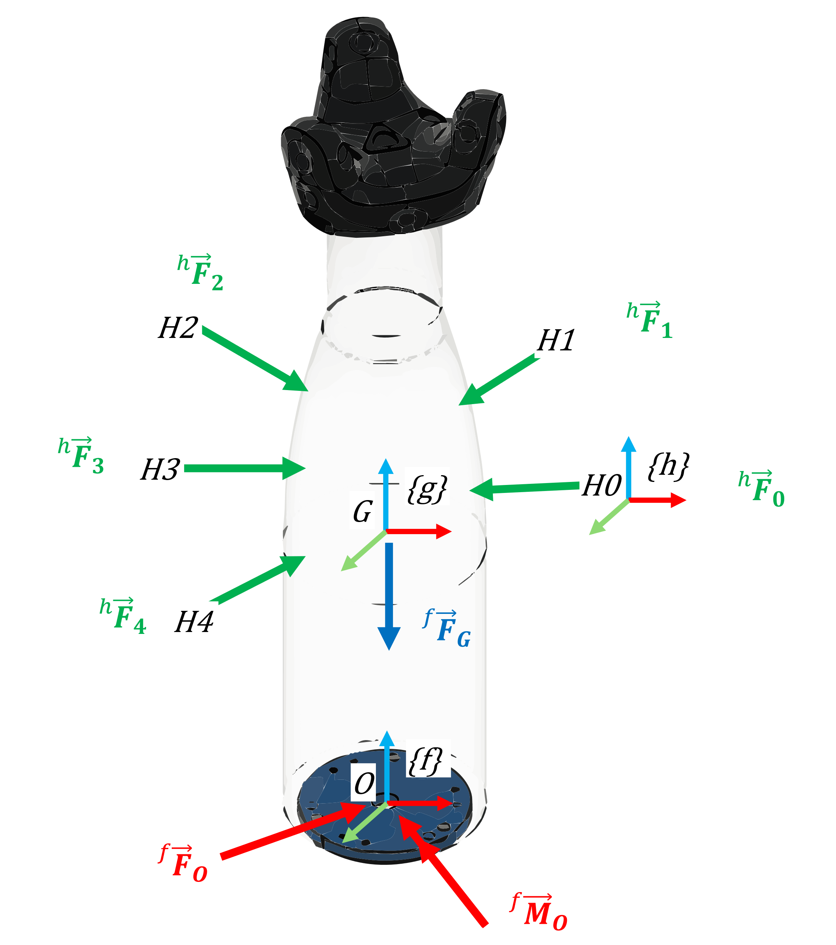
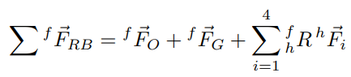
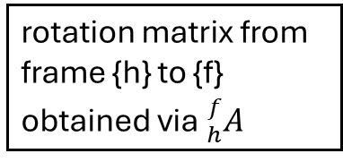
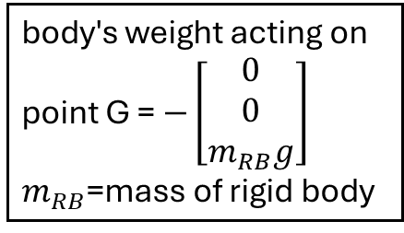
Dynamics (Resultant Forces)
body's weight acting on point G = $−\left[\begin{matrix}0 \\ 0 \\ m_{RB}g\end{matrix}\right]$
$m_{RB}$=mass of rigid body
constraint forces acting on point O
rotation matrix from frame {h} to {f} obtained via ${}_{h}^{f}A$
driving forces acting on the rigid body from a manipulator's hand / fingers expressed in frame {h}
Notes:
Include FBD, standardize the notations, for the static rigid body, start overleaf project to write the maths properly

Slide 5
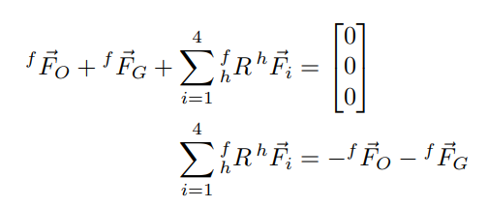
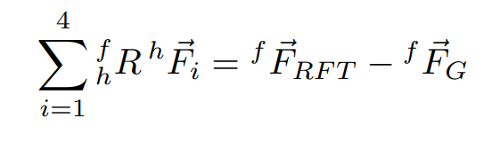
Dynamics (Linear NE)
RFT F/T sensor measures the forces acting on point O, in the opposite direction of the constraint force
Notes:
Include FBD, standardize the notations, for the static rigid body, start overleaf project to write the maths properly

Slide 6
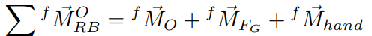
Dynamics (Resultant Moment)
constraint moments acting about point O
Moment about point O induced by body’s weight
Moment about point O induced by driving forces acting on the rigid body a manipulator's hand / fingers.
Notes:
Include FBD, standardize the notations, for the static rigid body, start overleaf project to write the maths properly

Slide 7
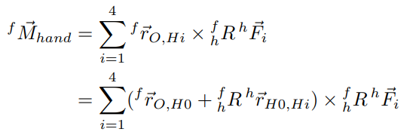
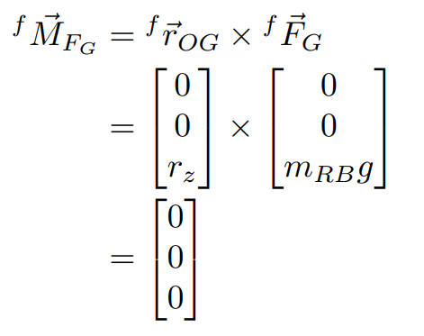
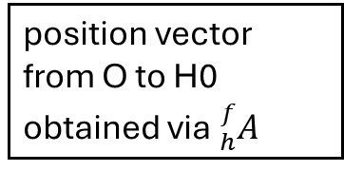
Dynamics (Resultant Moment)
position vector from O to H0 obtained via ${}_{h}^{f}A$
relative position from palm to finger given by glove
Notes:
Include FBD, standardize the notations, for the static rigid body, start overleaf project to write the maths properly

Slide 8
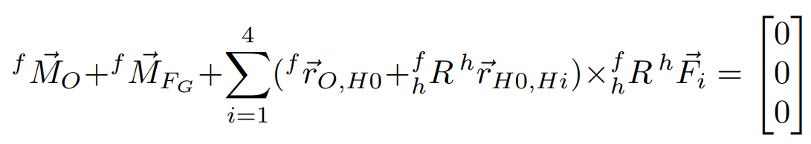
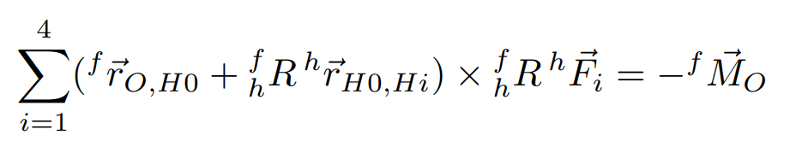
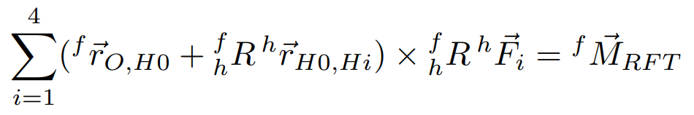
Dynamics (Angular NE)
RFT F/T sensor measures the moment acting on point O, in the opposite direction of the constraint moment
Notes:
Include FBD, standardize the notations, for the static rigid body, start overleaf project to write the maths properly

Slide 9
Summary
Experimental validation of the interaction on a STATIC RIGID BODY
force and position readings of the glove
and the wrench readings from the RFT F/T sensor has to satisfy
Notes:
Include FBD, standardize the notations, for the static rigid body, start overleaf project to write the maths properly

Slide 10
TransHap
TMRB
RAL?

